Slide 1
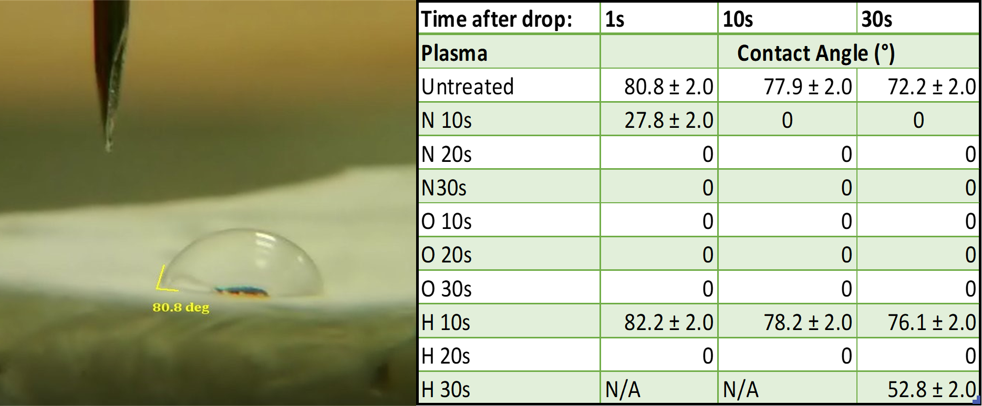
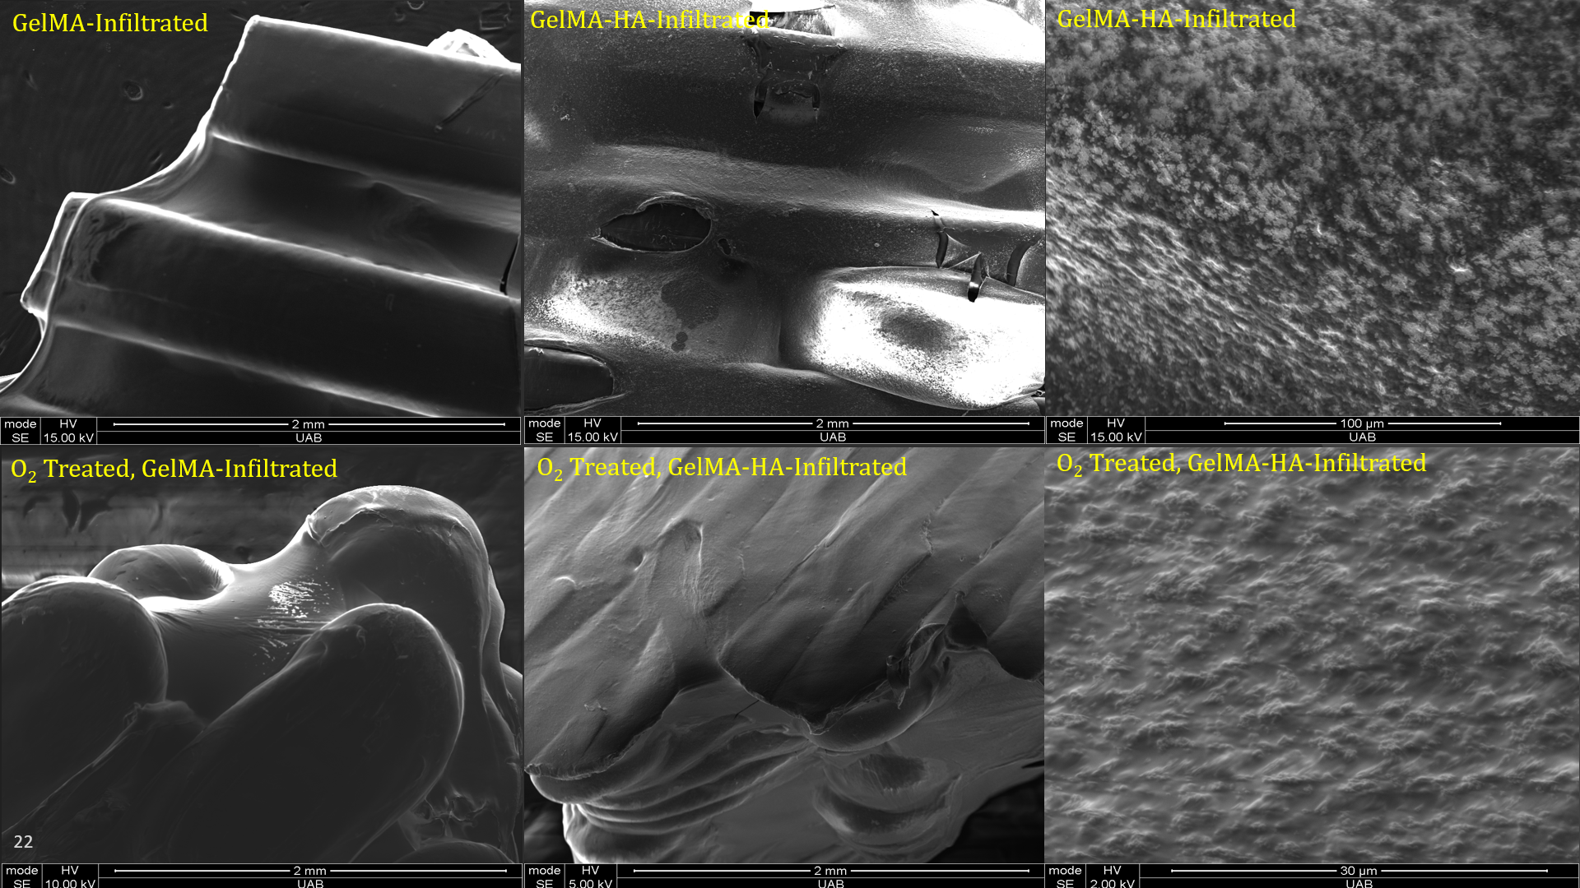
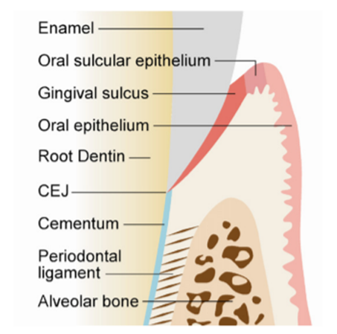
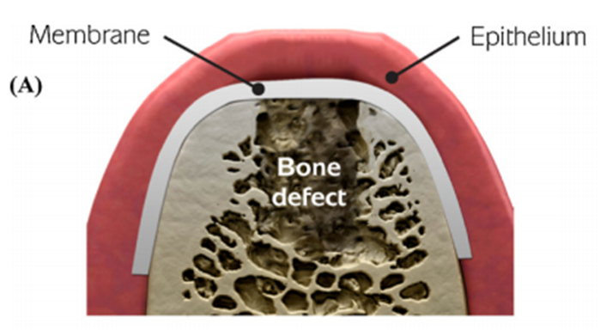
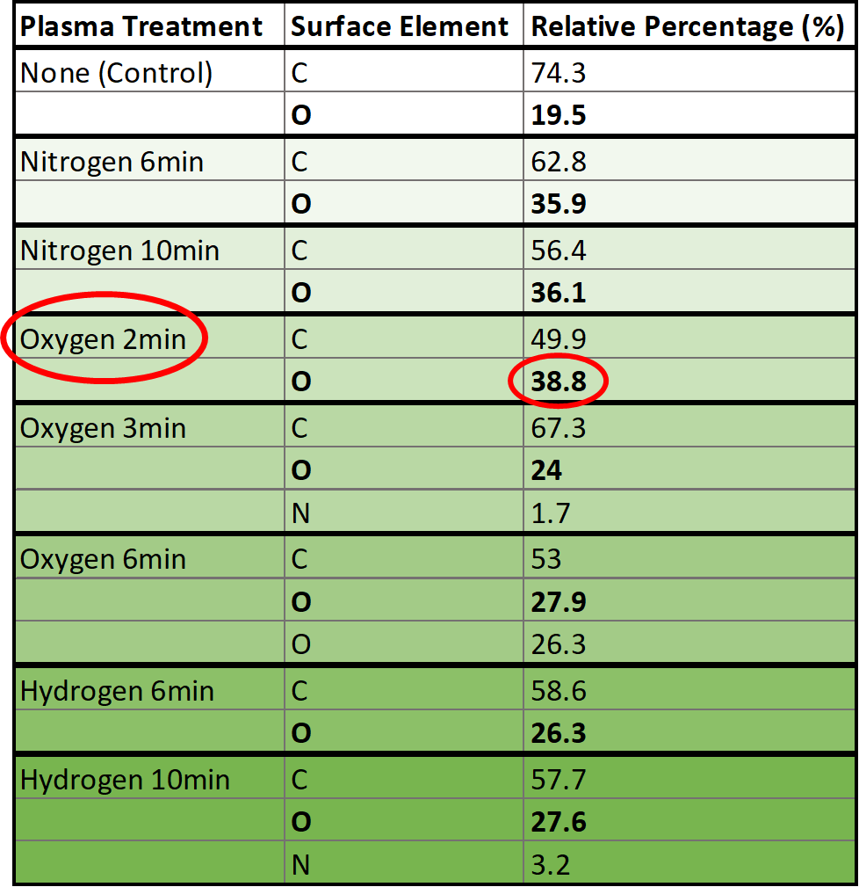
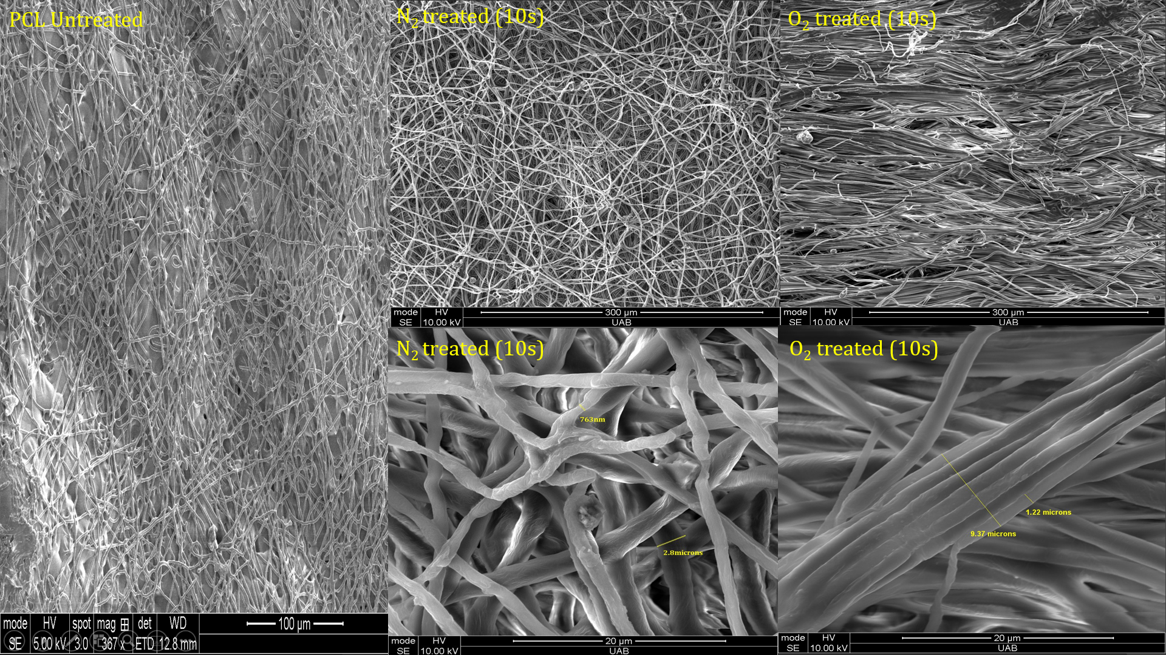

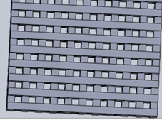
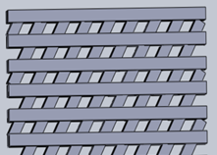
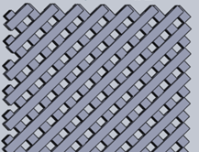
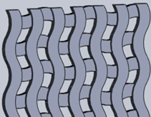
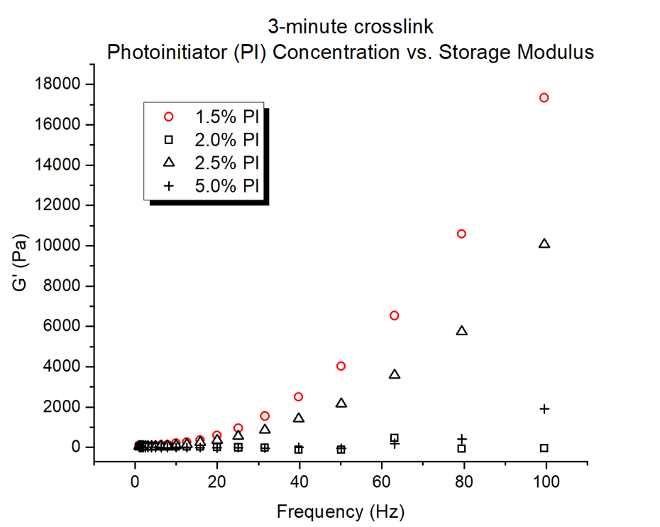
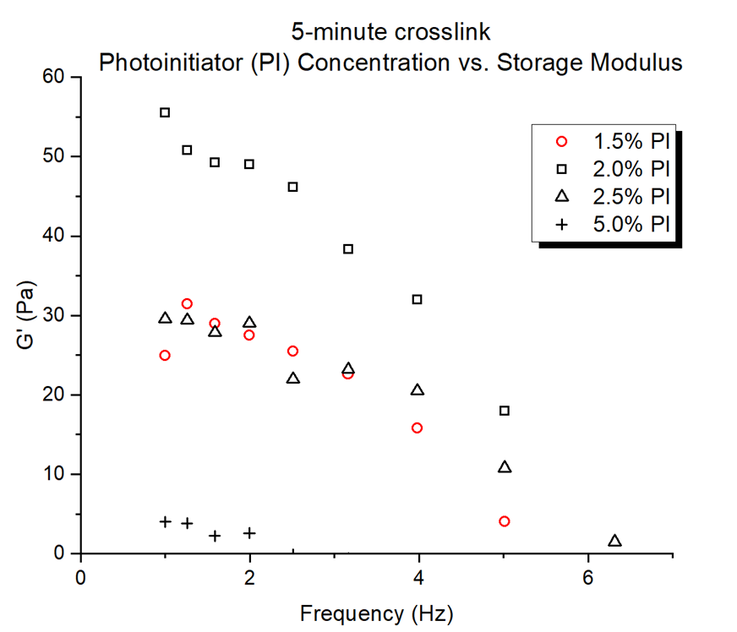
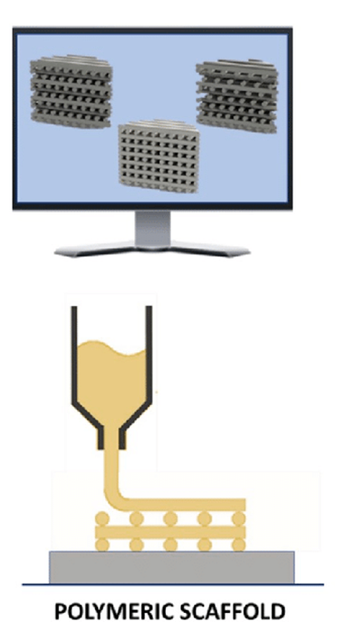
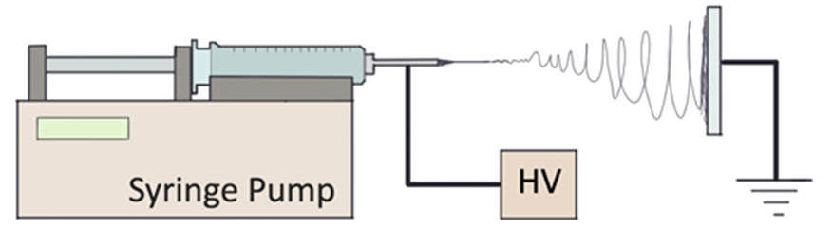
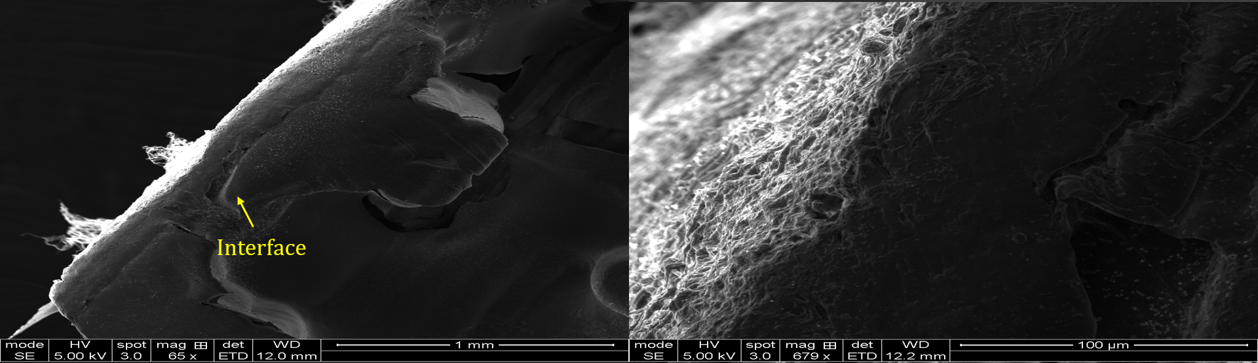
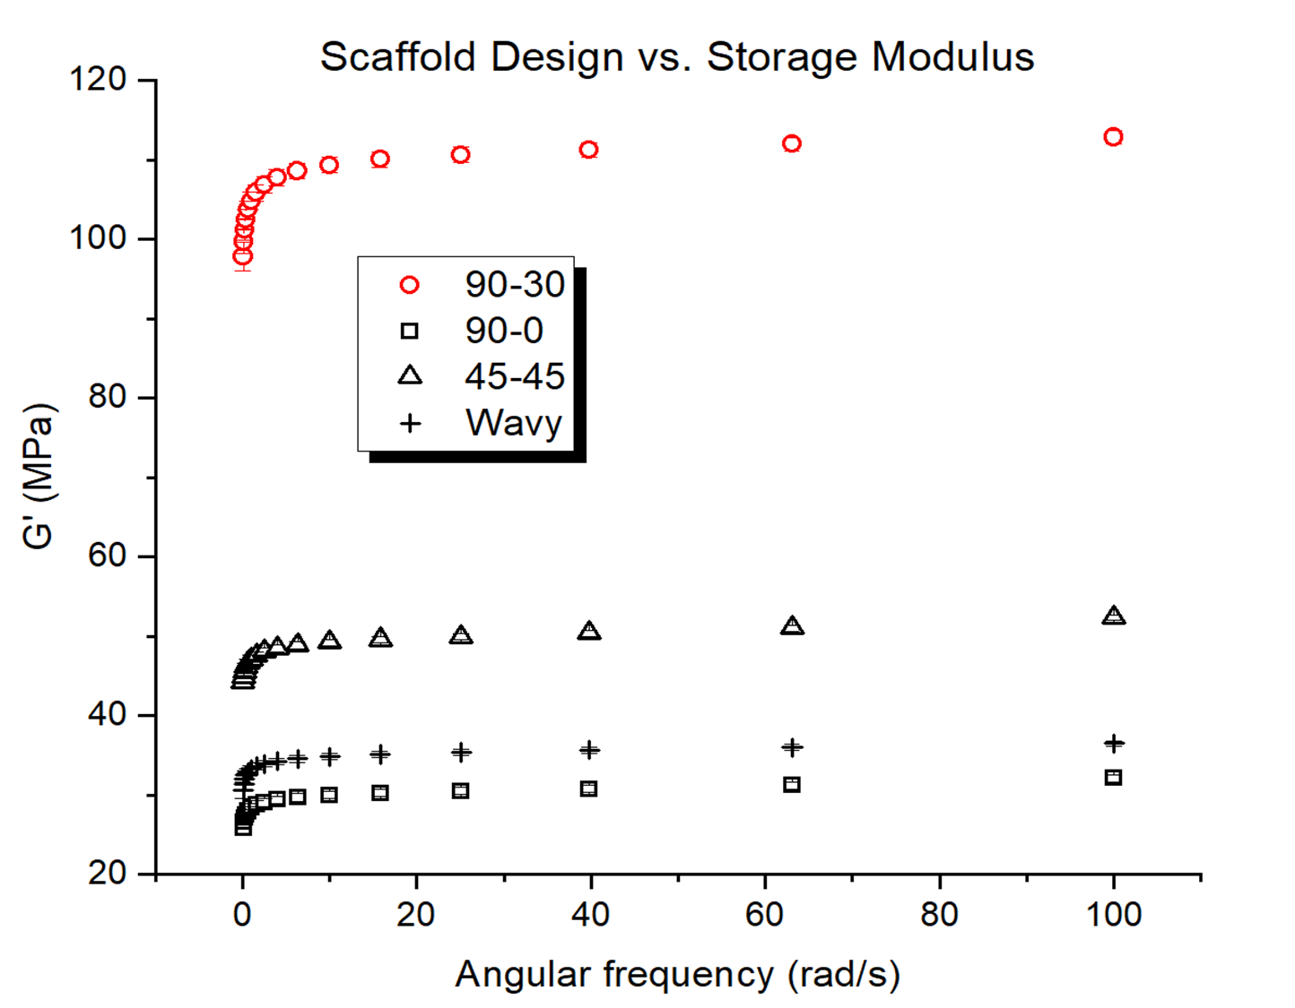
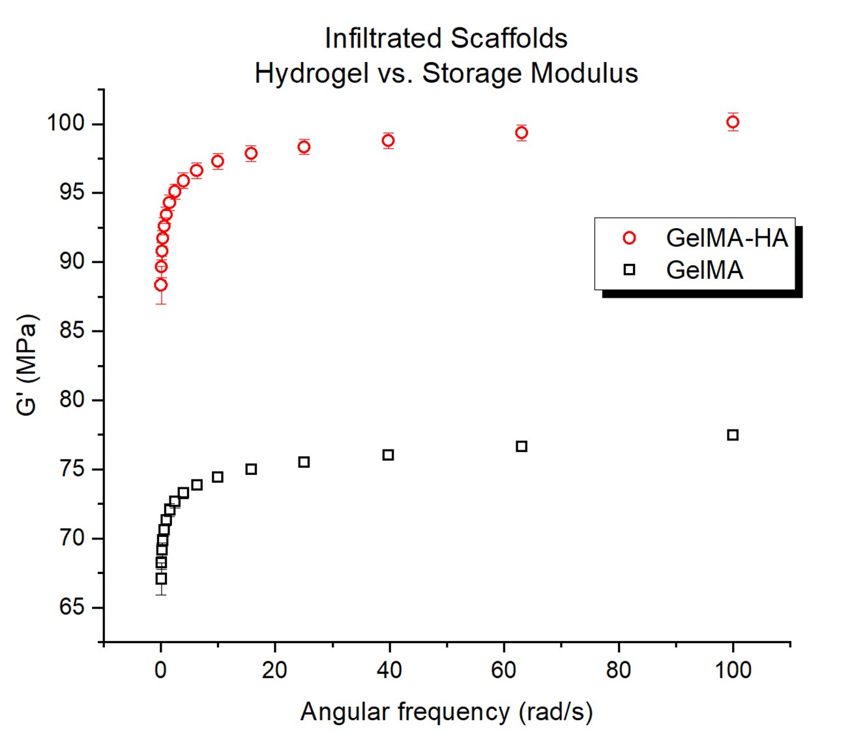
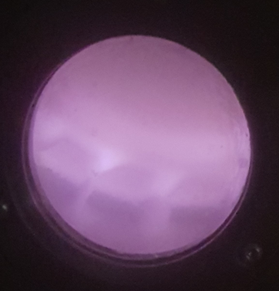
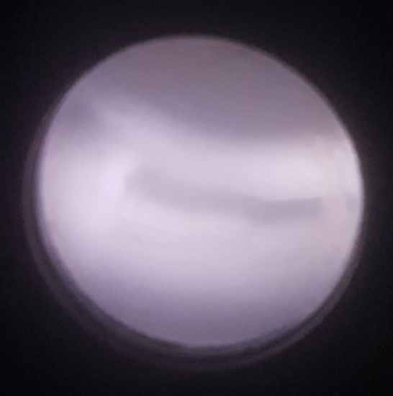
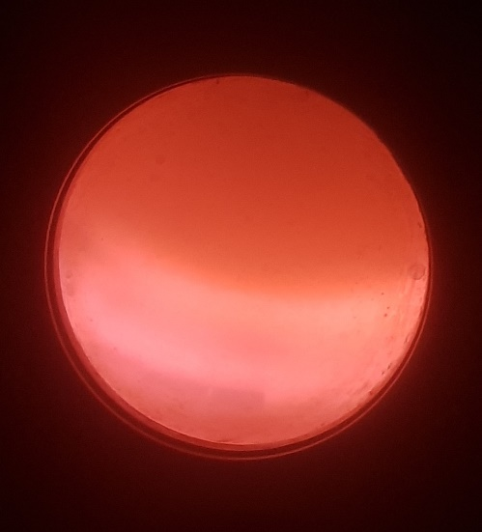
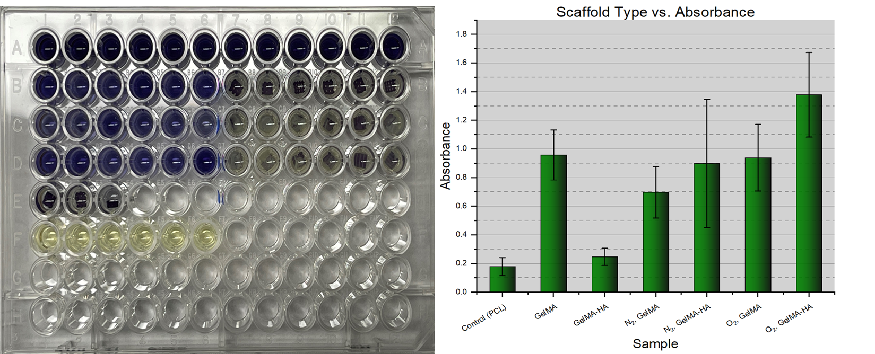
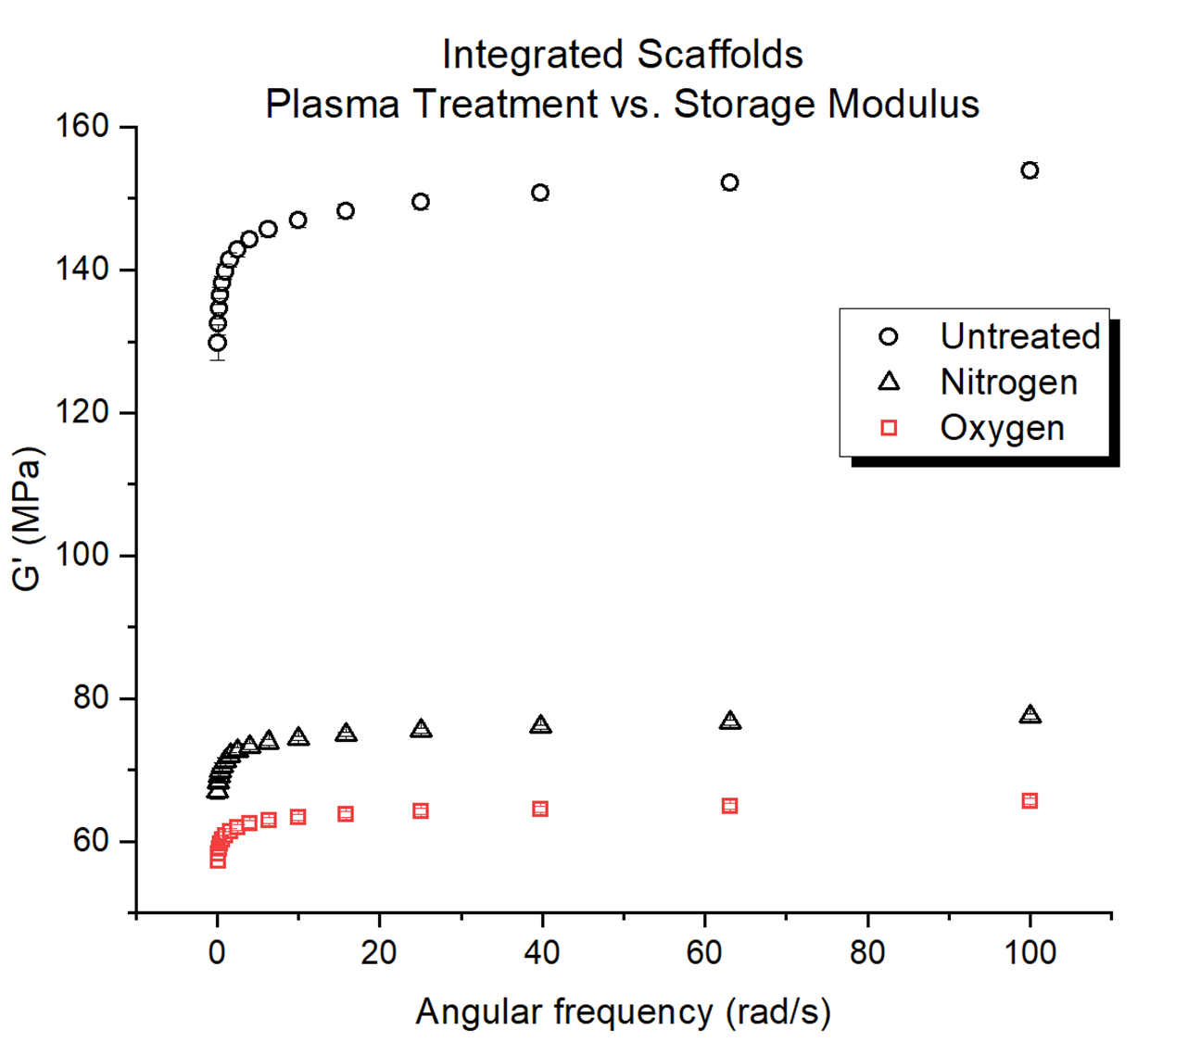

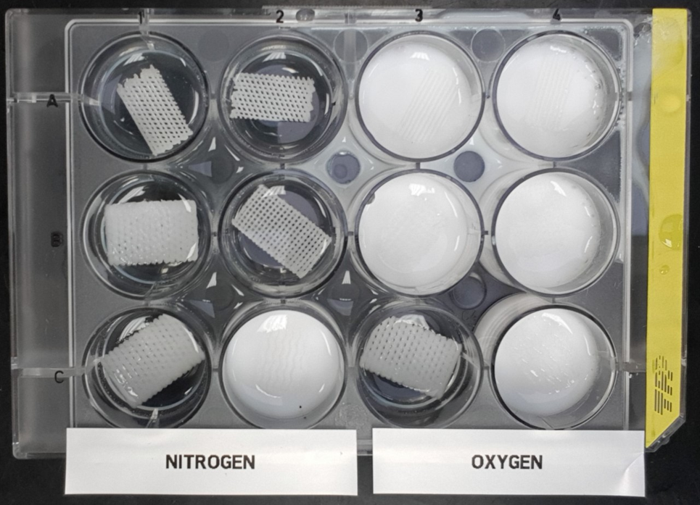


3D-Bioprinted PCL/GelMA-HA Scaffolds for Guided Bone Regeneration (GBR)
Ryan Roessler¹, Dr. Vinoy Thomas², Dr. Vineeth Vijayan³, Gerardo Hernandez⁴
ªUniversity of Alabama at Birmingham, Department of Materials Science & Engineering, ^{b}Center for Nanoscale Materials and Biointegration (CNMB), ^{c}Alabama State University
INTRODUCTION
RESULTS & DISCUSSION
RESULTS & DISCUSSION
Upon visual analysis of Figure 8, it appears as though the GelMA-HA
infiltrated samples did not perform as well as the GelMA infiltrated samples, despite HA’s ability to enhance bone cell growth. This is certainly an unexpected result. The reason for this may be attributed to the concentration of HA used in the formation of the hydrogel (5% w/v), or possibly the method of integration of HA with the hydrogel. These things should be further explored. Additionally, there is a discrepancy in this data when analyzing Figure 9. We believe this may be due to residual HA in the wells, which was absorbing light after removing the samples. Finally, it appears as though there might be a decrease in cell viability with the plasma treated samples versus the untreated ones. Cellular studies are inconclusive and will be repeated.
Periodontitis is a prolific, inflammatory gum disease that can eventually lead to tooth loss if untreated. Researchers are striving to create an ideal implantable device that will regenerate the lost tissue and ligament of the periodontium. Such an implant must be biocompatible, bioresorbable and bioactive, so that it can facilitate cell growth and proliferation. Polycaprolactone (PCL) scaffolds were 3D-printed and treated with non-equilibrium low-temperature plasma (LTP). Gelatin-methacryloyl (GelMA) and a GelMA-hydroxyapatite (HA) hydrogels were fabricated and optimized before being infiltrated into our scaffolds.
Hydrophilicity
Scanning Electron Microscopy (SEM) Imaging
A.)
B.)
LTP was shown to significantly increase hydrophilicity of the PCL scaffolds via water contact angle.
CONCLUSIONS & FUTURE STUDY
X-Ray Photoelectron Spectroscopy (XPS)
To the best of our knowledge, we have produced a unique type of membrane for GBR that has not been produced before.
Unexpectedly, LTP had adverse effects on the mechanical integrity of the infiltrated scaffolds as compared to the untreated ones, which was a surprising result that poses interesting questions regarding the effects of LTP on photopolymerization.
Through SEM, it appears that LTP (specifically with O₂) may enhance the effectiveness of scaffold infiltration with GelMA and GelMA-HA hydrogels.
Effects of LTP on the crosslinking process should be further investigated.
Degree of crosslinking should be measured after plasma treatment.
Mechanical strength of treated scaffolds should be tested both before and after infiltration.
This is an ongoing project with many of these experiments being repeated, especially the cellular study.
Figure 1: Diagram of periodontium, healthy (A) and unhealthy with membrane implant (B).
Figure 2: XPS data comparing relative atomic percentages of Carbon, Oxygen and Nitrogen on PCL scaffolds after varying plasma treatments. O₂ plasma treatment created the highest relative percentage of oxygen on the surface. O₂ plasma also has the ability to physically etch the surface of the treated material; this was observed for treatment times of 6+ minutes.
LTP was performed under 45W radio frequency (RF) with a flow rate of ~15sccm and a pressure of ~500mTorr.
Figure 5: Comparison of hydrogel infiltration before and after LTP.
Objective: Synthesize a biocompatible, bioresorbable, bioactive membrane, infiltrated with hydrogel, to fill the space of the defect and regenerate the surrounding tissue.
This study compares the effects of non-equilibrium, low-temperature plasma (LTP) treatment on the hydrophilicity, mechanical strength and cell viability of four scaffolds of varying design, while also exploring the infiltration success and properties of gelatin-methacrylol (GelMA) and GelMA-hydroxyapatite (HA) hydrogels.
It appears as though the O₂ treated scaffold resulted in a more successful, evenly coated infiltration, specifically with the GelMA-HA hydrogel.
MATERIALS & METHODS
1. Fabrication of Scaffolds
90°-0° 90°-30° 45°-45° Wavy
Mechanical Testing
Figure 6: Comparison of electrospun nanofibers before and after LTP.
REFERENCES
There is a noticeable difference in the structure of the fibers that have been treated with O₂ plasma. This may offer a way to better mimic the fibril bundle nature of the extra-cellular matrix (ECM).
[1] Marco C. Bottino, Vinoy Thomas, Gudrun Schmidt, Yogesh K. Vohra, TienMin Gabriel Chu, Michael J. Kowolik, Gregg M. Janowski, ’Recent advances in the development of GTR/GBR membranes for periodontal regeneration—A materials perspective’, Dental Materials, vol 28, Issue 7, 2012, pp 703-721. https://doi.org/10.1016/j.dental.2012.04.022
[2] Ligon SC, Husar B, Wutzel H, Homan R, Liska R. Strategies to reduce oxygen inhibition in photoinduced polymerization. Chem Rev. 2014 Jan 8;114(1):557-89.
doi: 10.1021/cr3005197
[3] Singh P, Carraher C, Schwarzbauer JE. Assembly of fibronectin extracellular matrix. Annu Rev Cell Dev Biol. 2010;26:397-419. doi: 10.1146/annurev-cellbio-100109-104020
[4] Guillen-Romero LD, Oropeza-Guzman´ MT, Lopez-Maldonado EA, Iglesias AL, ´ Paz-Gonzalez JA, Ng T, Serena-G ´ omez E, ´ Villarreal-Gomez LJ. Synthetic hydroxyapatite and its use in bioactive coatings. J Appl Biomater Funct Mater. 2019 Jan-Mar;17(1):2280800018817463. doi: 10.1177/2280800018817463
Four scaffold designs were created using SolidWorks CAD software. Polycaprolactone (PCL), a viscoelastic polyester, was 3D-printed with a Fused Deposition Modeling (FDM) MakerBot printer. A thin layer of PCL was then electrospun on top of the printed scaffold using a 20% w/v solution of PCL/HFIP.
Figure 3: Graphical data showing the optimal combination of 1.5% photoinitiator (PI) and a crosslinking time of 3 minutes for hydrogel.
A.)
B.)
Figure 7: Interface between electrospun and 3D-printed layers in bilayer scaffold.
ACKNOWLEDGEMENTS
2. Plasma Treatment of Scaffolds
Cell Viability
Support provided by National Science Foundation (Grant Number DMR DMR 1754078) - Research Experiences for Undergraduates (REU) award to UAB. Special thanks to the CNMB group and Alabama State University for giving us access to their equipment. Special thanks to Drs. Vinoy Thomas, Derrick Dean, Vineeth Vijayan and Paul Baker. I would also like to thank Gerardo Hernandez, Shruti Sanas, Renjith Rajan, Dr. Kiran Adhikari and Charita Cadenhead.
Scaffolds were treated with non-equilibrium, low-temperature plasma (LTP), using N₂, O₂ and H₂ gases shown from left to right.
3. Fabrication & Infiltration of Hydrogels
Photoinitiator Irgacure 2959 was added to GelMA and GelMA-hydroxyapatite (HA) at 1.5% w/v concentration and crosslinked for 3 minutes with a wavelength of 365nm.
C.)
Figure 4: Torsion tests showing a comparison of the storage moduli of scaffold designs (A), hydrogels (B) and infiltrated scaffolds after LTP (C).
The plasma treated scaffolds showed a lower strength than the untreated
scaffolds. This is an unexpected result, as we assumed the plasma treatment would enhance the interfacing quality with the hydrogel. We believe the reason for this is that the plasma treatment may be inhibiting the crosslinking process of the hydrogel.
Figure 8: 96-well plate in which the samples were loaded and MTT assay was performed. A1-A12: plated cells for a control. B1-B6: GelMA infiltrated, untreated scaffolds. B7-B12: GelMA-HA infiltrated, untreated scaffolds. C1-C6: GelMA infiltrated, N₂ treated scaffolds. C7-C12: GelMA-HA infiltrated, N₂ treated scaffolds. D1-6: GelMA infiltrated, O₂ treated scaffolds. D7-12: GelMA-HA infiltrated, O₂ treated scaffolds. E1-E3: untreated PCL scaffolds with no hydrogel infiltration. F1-F6: blank wells for control.
Figure 9: Graphical representation of the MTT assay showing the absorbance of each type of sample.

